Slide 1
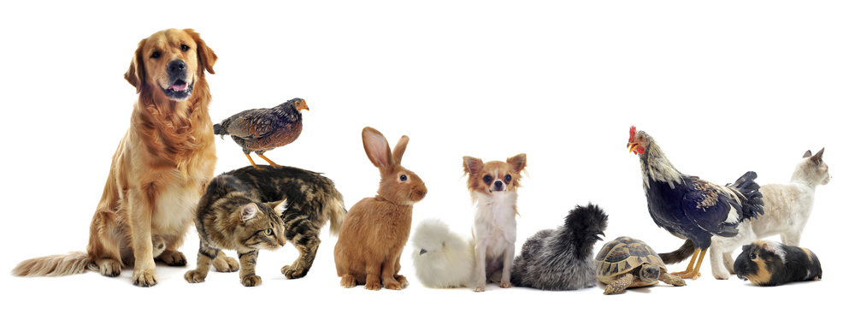
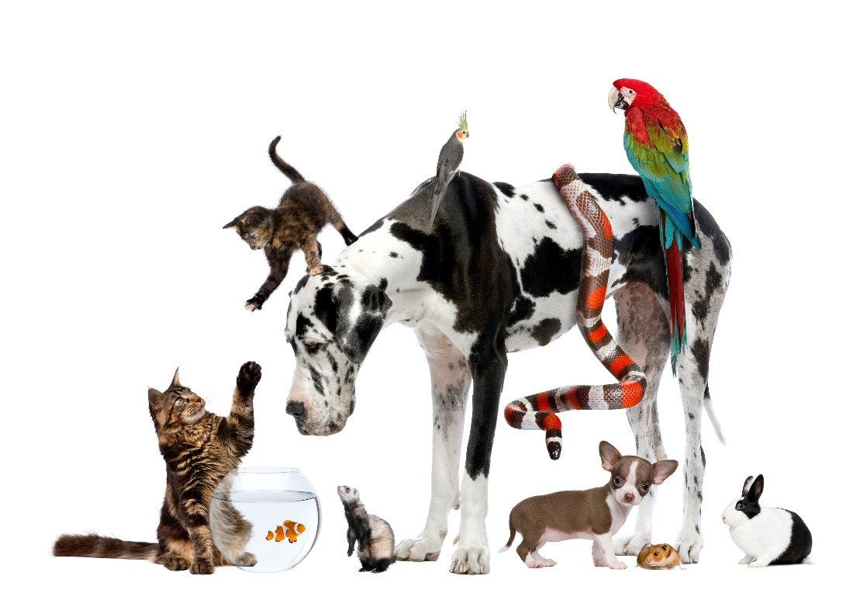
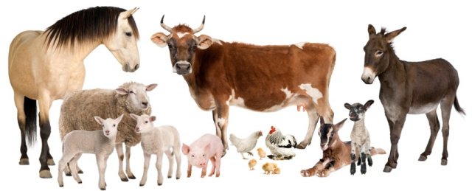
Variation

Slide 2
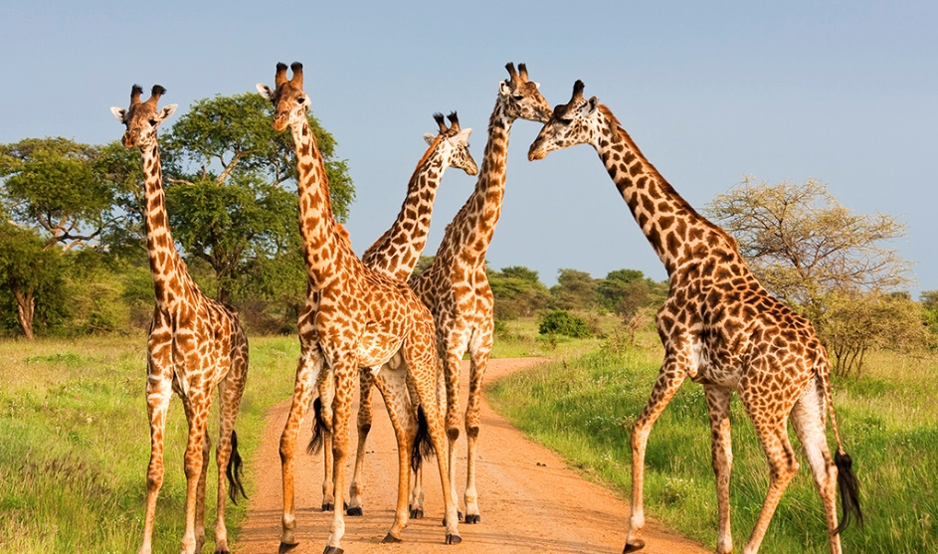
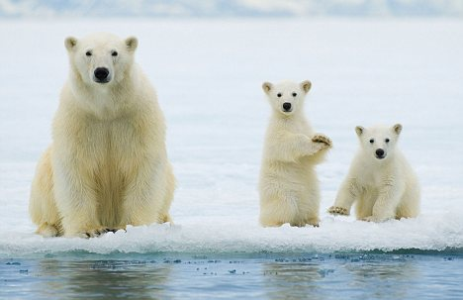
Learning objectives
To understand…
The importance of variation within a population of animals
That living things can change over many generations leading to their adaptation

Slide 3
Starter – Animals
Split the animals into fur vs. no fur
Now, split the animals into photosynthesis vs. no photosynthesis
Notes:
Listing animals
Split into groups (tables)
Each table have paper and pen and need to write down as many animals as they can think of in 2 minutes
Each group shares a selection of their animals (I will write on the board)
Teacher - “So many different animals around the world and these are only a tiny amount of the total… there are at least 900 thousand different types of insects in the world… still counting”

Slide 4
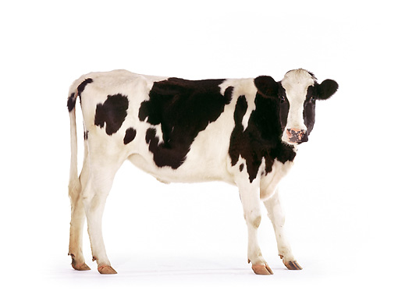
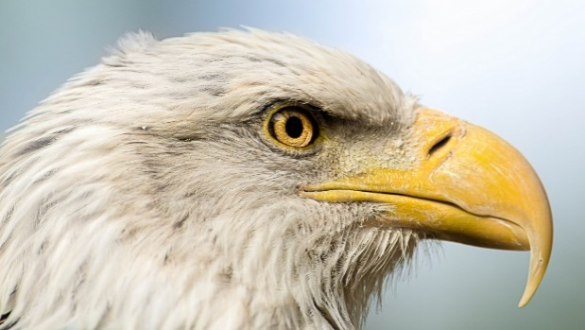
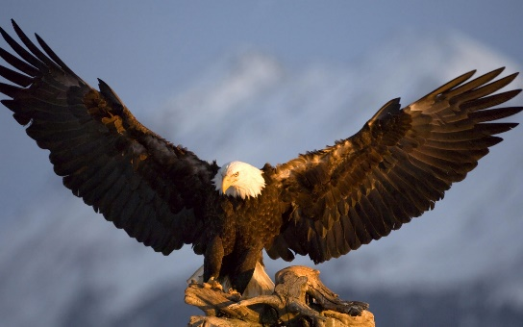
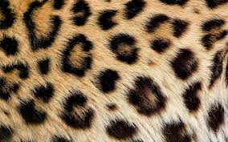
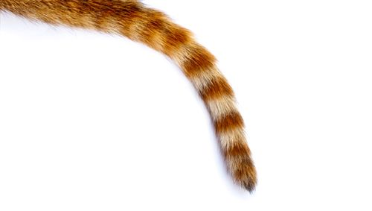
Characteristic – a feature or quality belonging to an organism
Can you think of some characteristics that these animals have?
Notes:
Teacher – “Can you think of some characteristics?” (Write on board)
Student egs. Fur, beak, wings, number of limbs, tail, feathers etc

Slide 5
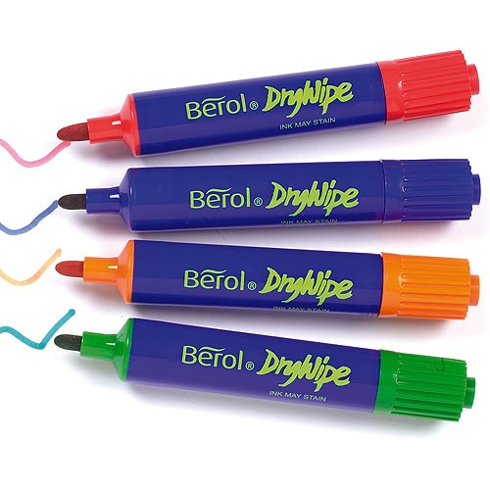
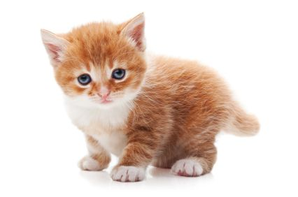
Starter – Animals
How many animals can you think of?
Notes:
Listing animals
Split into groups (tables)
Each table have paper and pen and need to write down as many animals as they can think of in 2 minutes
Each group shares a selection of their animals (I will write on the board)
Teacher - “So many different animals around the world and these are only a tiny amount of the total… there are at least 900 thousand different types of insects in the world… still counting”

Slide 6
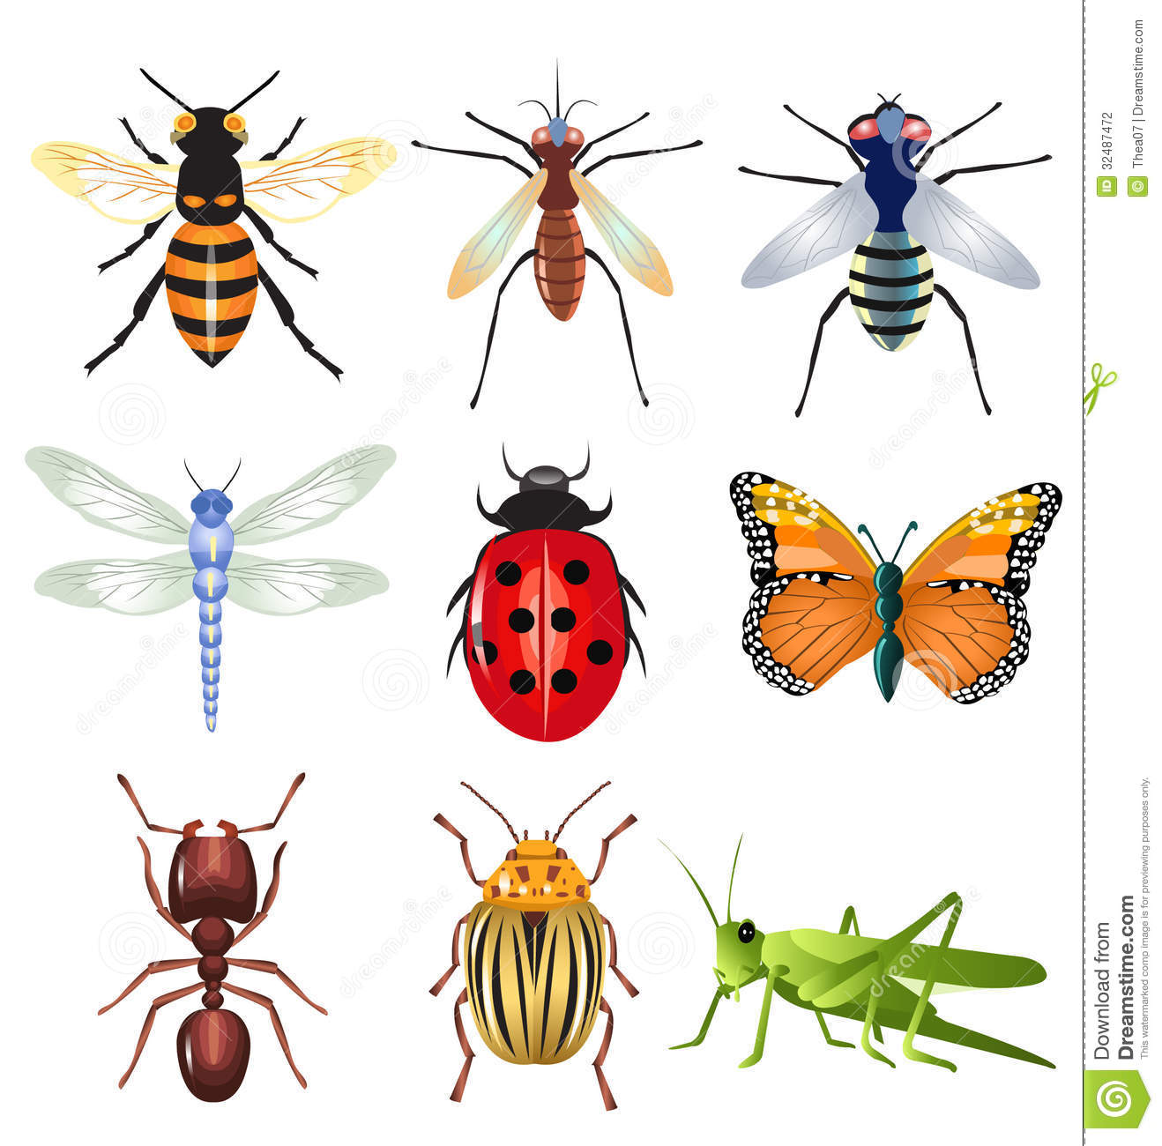
Are all these animals identical?
There are at least 900 thousand different types of insect in the world! And we are still counting….
Notes:
Teacher - “Are these animals identical?”
Students – “No all are different”
Teacher – “Exactly, this is variation. All of these animals (on the board) are different, the scientific way of explaining this is that there is variation between all the animals.”

Slide 7
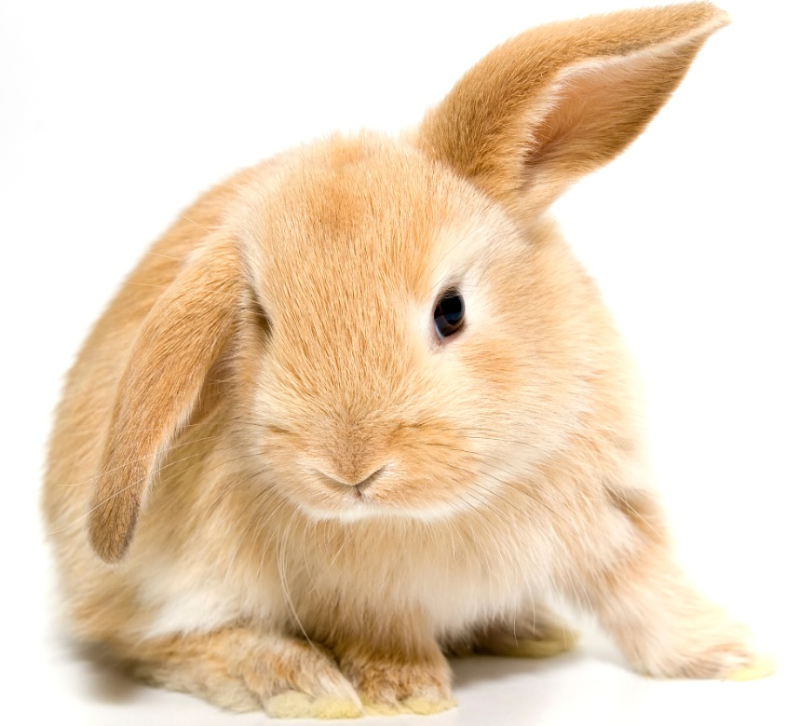
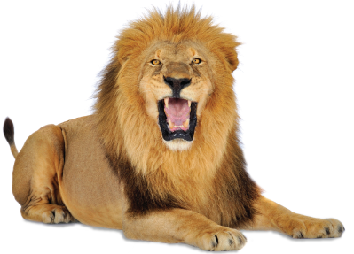
Common characteristics and variation between…
Lions
Rabbit
Notes:
Teacher – Ask pupils to discuss variations and common characteristics between lion and rabbit
Teacher – “Well done. Somes up how different species have common characteristics as well as differences (variations) – try to introduce the word variation more to replace differences

Slide 8
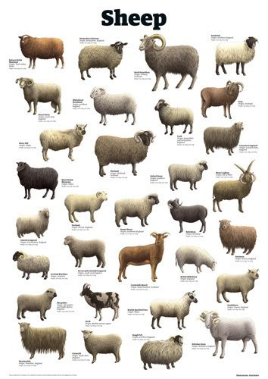
Species - A group of closely related organisms that are very similar to each other and are usually capable of interbreeding

Slide 9
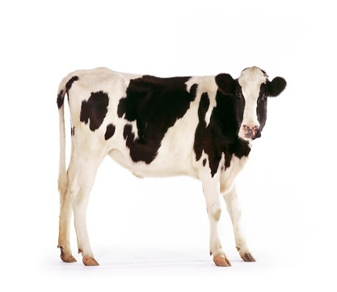


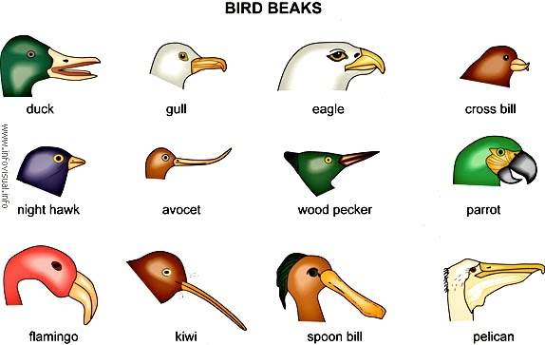
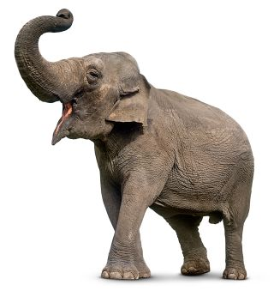
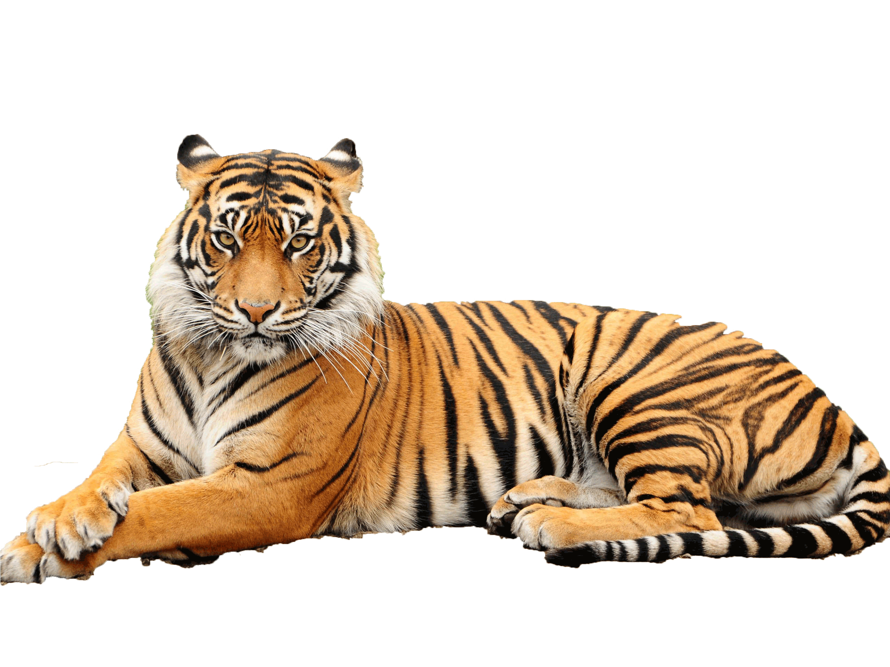
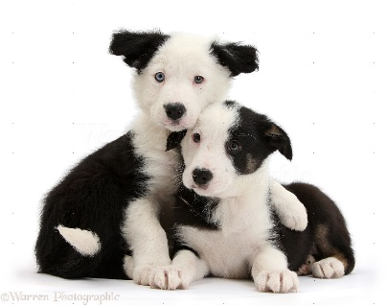
Can you remember what characteristic and variation means?
Characteristic – a feature or quality belonging to an organism
Variation – Difference in size, colour, presence of a trait or characteristic within a species/population
Notes:
Ask students if they remember what they mean

Slide 10
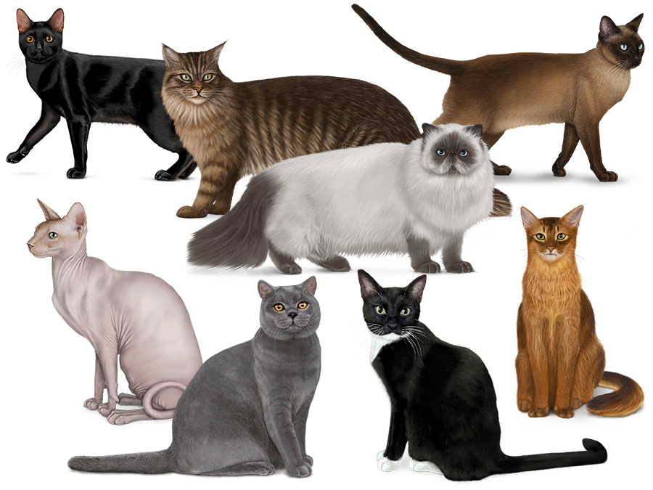
Cat characteristics
There is variation within a species
Colour
Long/Short Hair
Size Ear shape
Pattern
Fluffy/Smooth Coat
Eye colour
Notes:
Have similar characteristics so that you knew they were dogs…. But variations between breeds

Slide 11
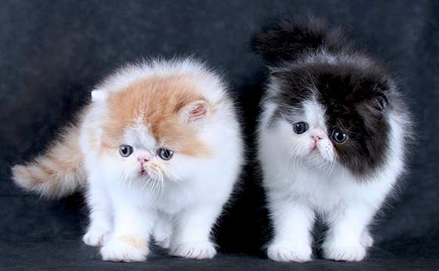
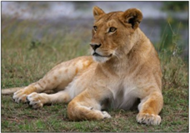
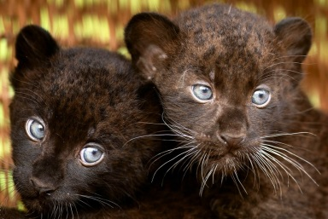
Activity - Parent and Offspring matching game
Teams must match up the parent with the offspring
When complete shout VARIATION
I will check if they are correct
Notes:
Are all varieties of dogs identical?
How could you tell who the puppies’ parents were?
Ask if the puppy is identical to its parent?
Ask students what is the same and what is different
Do the puppies look more like their mothers or puppies from other dog varieties?
Teacher – “Sum up – They have similar characteristics so you could tell that they are related however they have differences so they aren’t identical.”

Slide 12
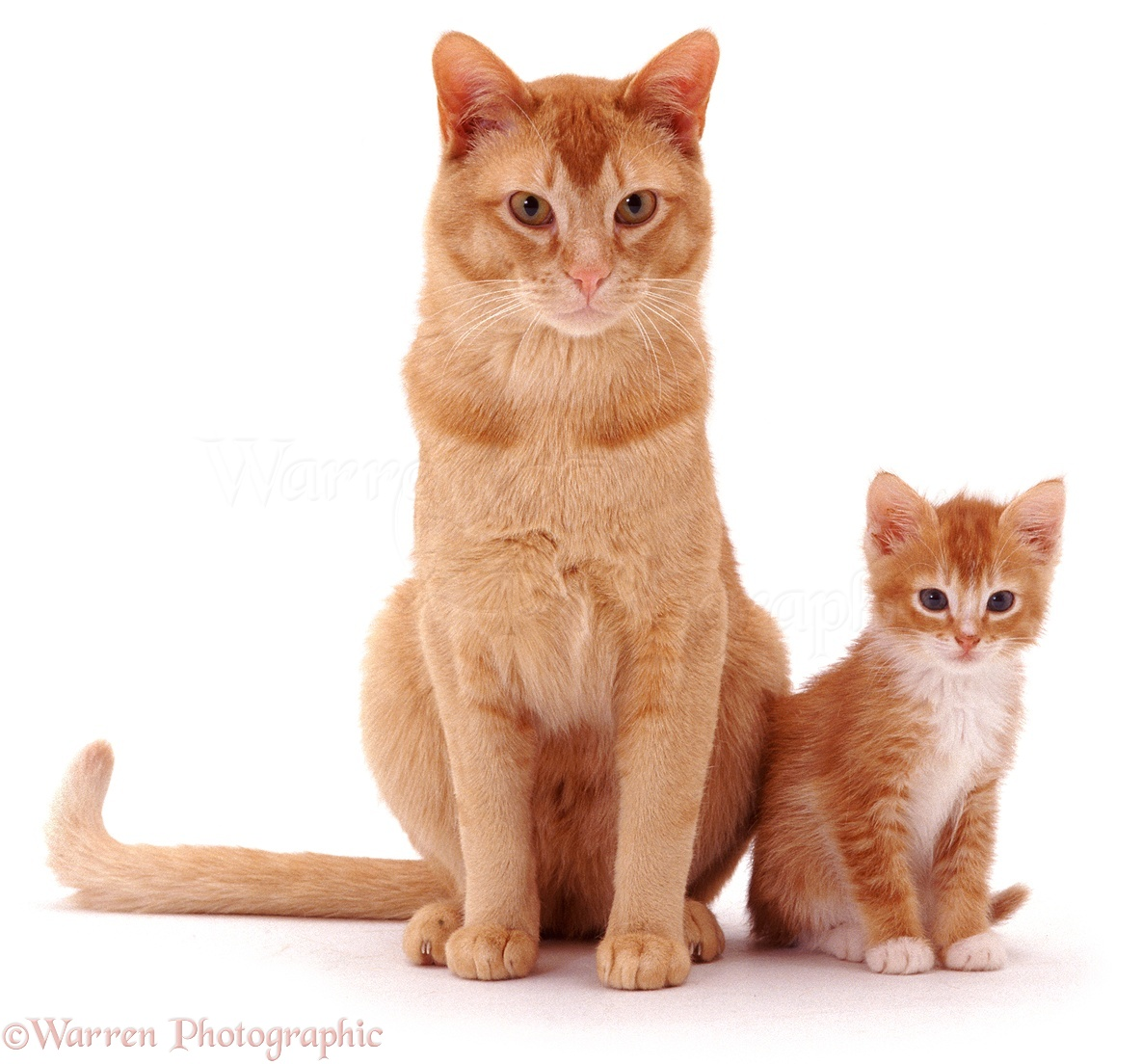
Inheritance – when characteristics are passed on to offspring from parents
Notes:
Offspring are a mixture of both their mum and dad because each parent pass on different characteristics” The scientific word for this is inherit.

Slide 13
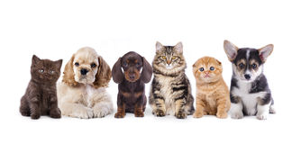
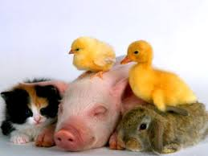
Offspring – an animals young

Slide 14
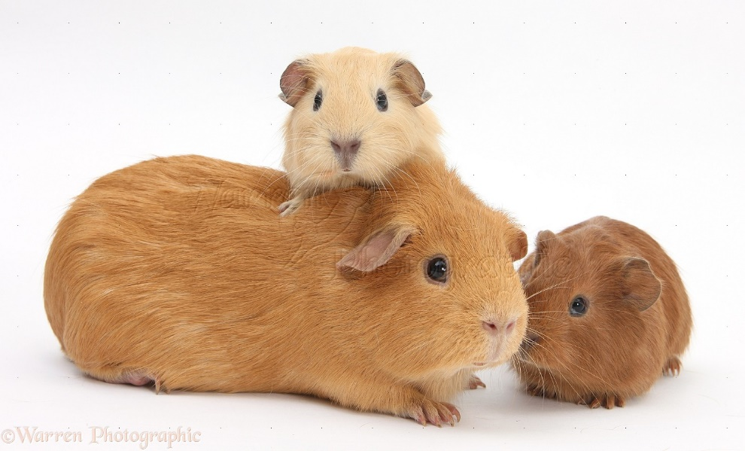
Where we get our information from…
All living organisms have all the information they need to grow and develop
Offspring inherit information from their parents which is why they have similar appearance to them.
Not everyone has exactly the same information, this is why we see variation
Notes:
All living organisms have all the information they need to grow and develop in a code called DNA
Parents pass on their DNA to their children which is why they have similar appearance to their parents. Half from your mum and half from your dad.
Not everyone has the same information (DNA) that is why we see variation.

Slide 15
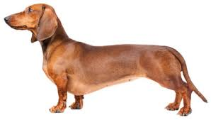
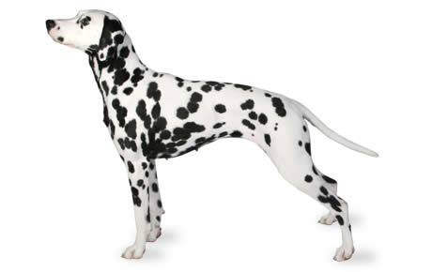
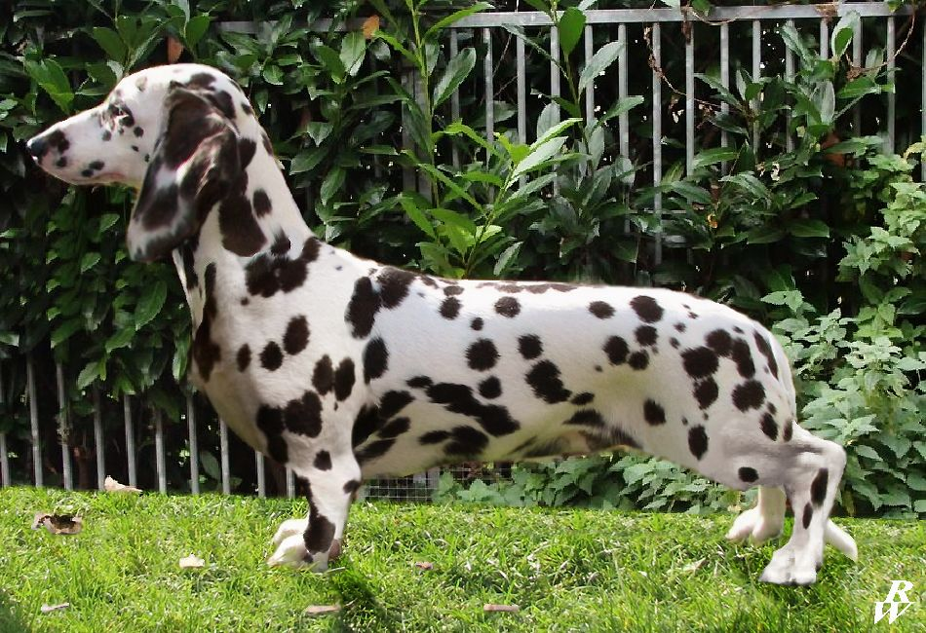
Can you identify which characteristics came from which parent of this dalmaschund?
Parents
Dalmaschund
Notes:
“Can you identify which information came from which parent of this dalmaschund?”

Slide 16
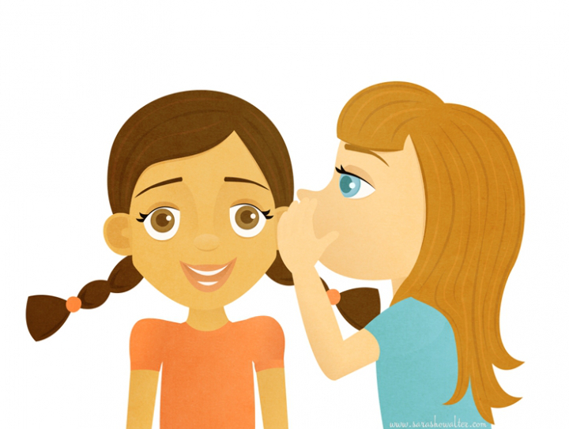
Activity 3 - Secret DNA message activity – need DNA messages!
Each table has 4 secret DNA messages
Read the first secret DNA message
Memorize it
Speak this message quietly into the ear of a member of your group(like Chinese whispers!).
Last member to hear the message writes it down in the Answer sheet.
Repeat for each DNA message
Notes:
Are all the messages identical?
Were they all correct?
Count how many mistakes you have?
Is there a relationship between the length of message and number of errors?

Slide 17
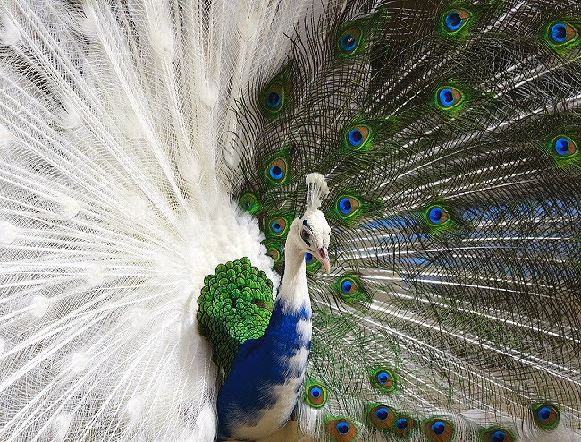
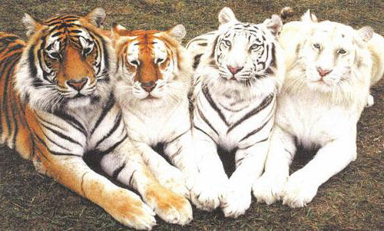
New characteristics can appear from mutations
Mutation – When information is passed from one generation to the next and a mistake is made by chance causing a small change in the appearance

Slide 18
Mutations
Mutations can cause small changes to the appearance eg. shorter legs, spotty fur, longer tail
Mutations occur by chance, so the longer the message the more chance for an error to occur
In a human, around 10-100 mistakes occur during a lifetime

Slide 19
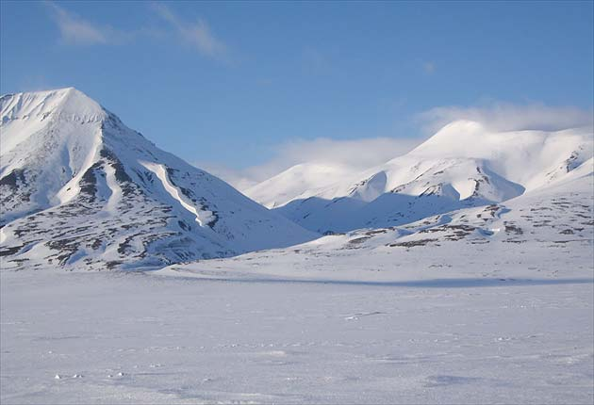
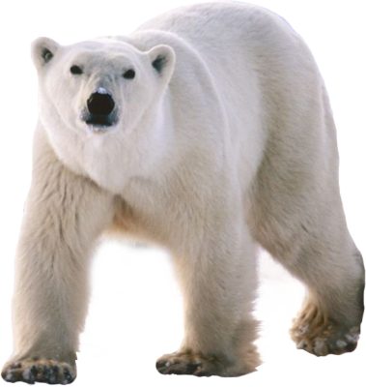
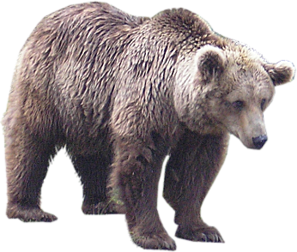
Certain characteristics are needed for different environments

Slide 20
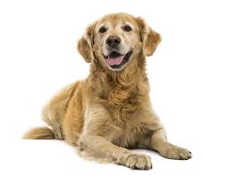
Variation – Difference in size, colour, presence of a characteristic within a species/population

Slide 21


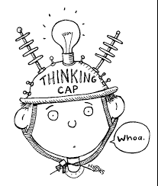
If the world got 5 degrees warmer, think about:
- Which animals and plants are likely to survive?
- Which animals and plants might become extinct?

